Slide 1
Artificial Intelligence
Lecture 7: Reinforcement Learning

Slide 2
Review: Artificial Intelligence
Supervised learning
Classification
Regression
Unsupervised learning
Clustering
Dimensionality reduction
Reinforcement learning
more general than supervised/unsupervised learning
learn from interaction w/ environment to achieve a goal
environment
reward
new state
action
agent
Notes:
‘

Slide 3
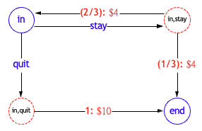
Review: Markov Decision Process (MDPs)
Definition: Markov decision process
States: the set of states
s_{start} ∈ States: starting state
Actions(s): possible actions from state s
T (s, a, s’): probability of s’ if take action a in state s
Reward (s, a, s’): reward for the transition (s, a, s’)
IsEnd(s): whether at end of game
0 ≤ γ ≤ 1: discount factor (default: 1)
Notes:
‘

Slide 4
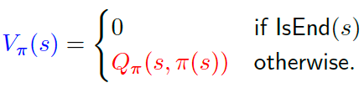
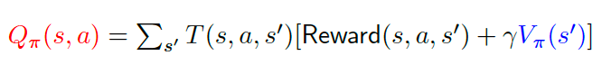
Review: Markov Decision Process (MDPs)
Following a policy π produces a path (episode)
s₀; a₁, r₁, s₁; a₂, r₂, s₂; a₃, r₃, s₃; . . . ; a_{n}, r_{n}, s_{n}
Value function V_{π} (s): expected utility if follow π from state s
Q-value function Q_{π} (s, a): expected utility if first take action a from state s and then follow π
CS221 / Autumn 2019 / Liang & Sadigh
Notes:
‘

Slide 5
Unknown transitions and rewards
Definition: Markov decision process
States: the set of states
s_{start} ∈ States: starting state
Actions(s): possible actions from state s
IsEnd(s): whether at end of game
0 ≤ γ ≤ 1: discount factor (default: 1)
Notes:
‘

Slide 6
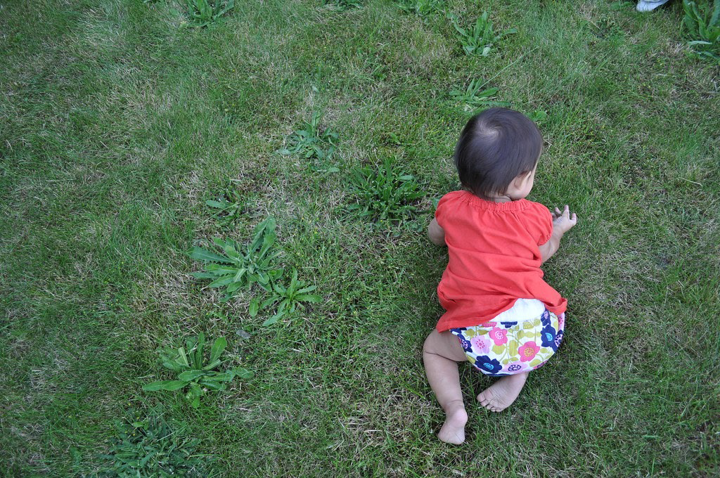
Learn to make good sequences of decisions
Notes:
‘

Slide 7
Learning from Experience Plays a Role in …
Artificial Intelligence
Control Theory and
Operations Research
Psychology
Reinforcement
Learning (RL)
Neuroscience
Artificial Neural Networks

Slide 8
What is Reinforcement Learning
Fundamental challenge in artificial intelligence and machine learning is learning to make good decisions under uncertainty

Slide 9
What is Reinforcement Learning
People and animals learn by interacting with our environment
This differs from certain other types of learning
It is active rather than passive
Interactions are often sequential — future interactions can depend on earlier ones
We are goal-directed
We can learn without examples of optimal behaviour
Instead, we optimise some reward signal

Slide 10
The reward hypothesis
Reinforcement learning is based on the reward hypothesis:
Any goal can be formalized as the outcome of maximizing a cumulative reward

Slide 11
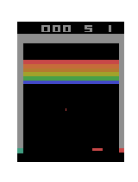

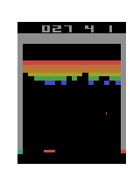
2010s: New Era of RL. Atari
Before any training
In early stages of training
In later stages of training
https://www.youtube.com/watch?v=V1eYniJ0Rnk
DeepMind Nature, 2015

Slide 12
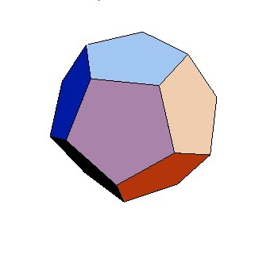
Mystery game
Example: mystery buttons
For each round r = 1, 2, . . .
You choose A or B.
You move to a new state and get some rewards.
Start
A B
Rewards:
5,0
0
State:

Slide 13
Mystery game
Example: mystery buttons
For each round r = 1, 2, . . .
You choose A or B.
You move to a new state and get some rewards.
Start
A B
Rewards:
?
?
State:

Slide 14
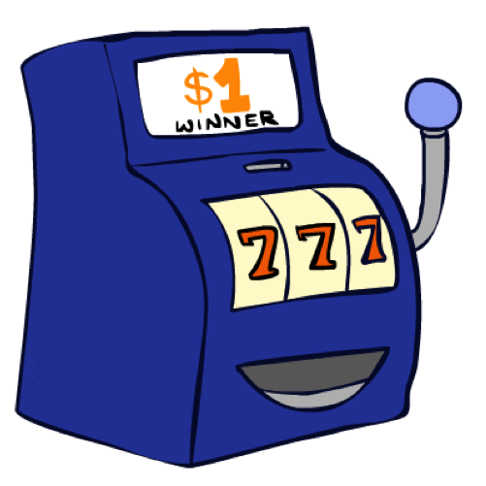
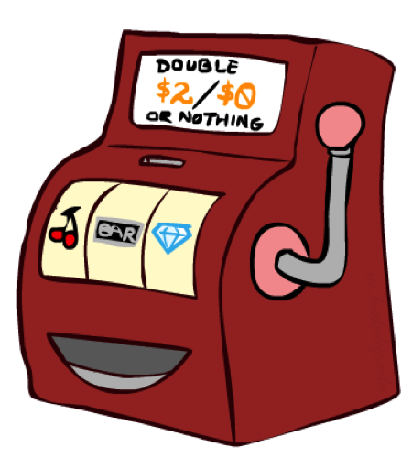

Double Bandits

Slide 15
Offline Planning
Solving MDPs is offline planning
You determine all quantities through computation
You need to know the details of the MDP
You do not actually play the game!
No discount
100 time steps
Both states have the same value
0.25 $0
Value
0.75
$2
W
0.25
$0
Play Red
150
L
$1
1.0
$1
1.0
0.75 $2
Play Blue
100

Slide 16
Let’s Play!
$2
$2
$0
$2
$2
$2
$2
$0
$0
$0

Slide 17
Online Planning
Rules changed! Red’s win chance is different.
?? $0
??
$2
W
L
??
$0
$1
1.0
$1
1.0
?? $2

Slide 18
Let’s Play!
$0
$0
$0
$2
$0
$2
$0
$0
$0
$0

Slide 19
What Just Happened?
That wasn’t planning, it was learning!
Specifically, reinforcement learning
There was an MDP, but you couldn’t solve it with just computation
You needed to actually act to figure it out
Important ideas in reinforcement learning that came up
Exploration: you have to try unknown actions to get information
Exploitation: eventually, you have to use what you know
Regret: even if you learn intelligently, you make mistakes
Sampling: because of chance, you have to try things repeatedly
Difficulty: learning can be much harder than solving a known MDP

Slide 20


From MDPs to reinforcement learning
Markov decision process (offline)
Have mental model of how the world works.
Find policy to collect maximum rewards.
Reinforcement learning (online)
Don’t know how the world works.
Perform actions in the world to find out and collect rewards.

Slide 21
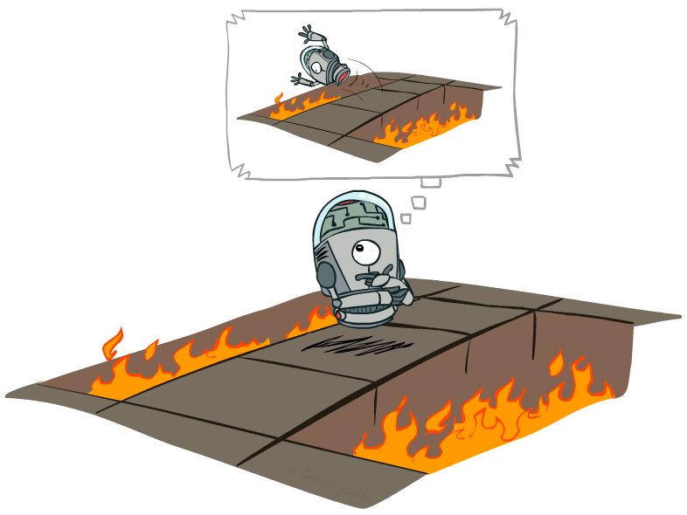
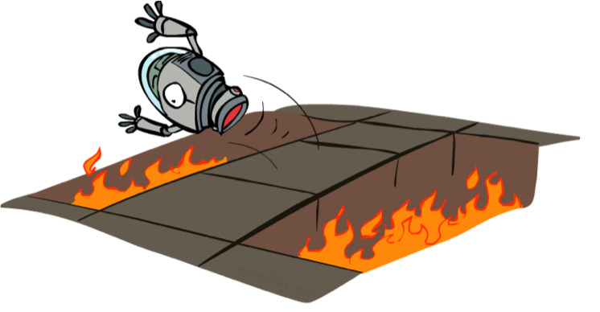
Offline (MDPs) vs. Online (RL)
Offline Solution
Online Learning

Slide 22
Reinforcement Learning
Agent
State: s
Reward: r
Actions: a
Environment
Basic idea:
Receive feedback in the form of rewards
Agent’s utility is defined by the reward function
Must (learn to) act so as to maximize expected rewards
All learning is based on observed samples of outcomes!
Notes:
Show robot-soccer learning to walk videos (UT Austin):
? Show snake robot:

Slide 23

Reinforcement Learning
Agent
state: s’
reward: r
Actions: a
Environment
Algorithm: reinforcement learning
For t = 1, 2, 3, . . .
Choose action a_{t} = π_{act}(s_{t−1}) (how?)
Receive reward r_{t} and observe new state s_{t}
Update parameters (how?)
Notes:
Show robot-soccer learning to walk videos (UT Austin):
? Show snake robot:

Slide 24
Reinforcement Learning
Still assume a Markov decision process (MDP):
A set of states s ∈ S
A set of actions (per state) A
A model T(s,a,s’)
A reward function R(s,a,s’)
Still looking for a policy π(s)
New twist: don’t know T or R
I.e. we don’t know which states are good or what the actions do
Must actually try out actions and states to learn

Slide 25

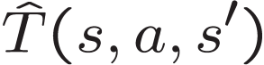
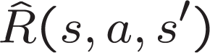

Model-Based Learning
Model-Based Idea:
Learn an approximate model based on experiences
Solve for values as if the learned model were correct
Step 1: Learn empirical MDP model
Count outcomes s’ for each s, a
Normalize to give an estimate of
Discover each when we experience (s, a, s’)
Step 2: Solve the learned MDP
For example, use value iteration, as before

Slide 26

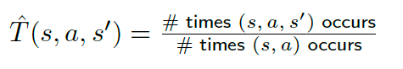
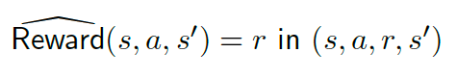
Model-Based Learning
Data: s₀; a₁, r₁, s₁; a₂, r₂, s₂; a₃, r₃, s₃; . . . ; a_{n}, r_{n}, s_{n}
Transitions:
Rewards:
Key idea: model-based learning
Estimate the MDP: T (s, a, s’) and Reward(s, a, s’)

Slide 27
Model-Based Learning
Data (following policy π(s) = stay):
[in; stay, 4, in; stay, 4, in; stay, 4, in; stay, 4, end]
Transition?
Reward?
(?): $?
in stay
in,stay
quit
(?): $?
in,quit
?: $?
end

Slide 28
Model-Based Learning
Data (following policy π(s) = stay):
[in; stay, 4, in; stay, 4, in; stay, 4, in; stay, 4, end]
(?): $4
in stay
in,stay
quit
(?): $4
in,quit
?: $?
end

Slide 29
Model-Based Learning
Data (following policy π(s) = stay):
[in; stay, 4, in; stay, 4, in; stay, 4, in; stay, 4, end]
(3/4): $4
in stay
in,stay
quit
(1/4): $4
in,quit
?: $?
end

Slide 30
Model-Based Learning
Data (following policy π(s) = stay):
[in; stay, 4, in; stay, 4, end]
New Transition?
(3/4): $4
in stay
in,stay
quit
(1/4): $4
in,quit
?: $?
end

Slide 31
Model-Based Learning
Data (following policy π(s) = stay):
[in; stay, 4, in; stay, 4, end]
(4/6): $4
in stay
in,stay
quit
(2/6): $4
in,quit
?: $?
end

Slide 32
Model-Based Learning
Data (following policy π(s) = stay):
[in; stay, 4, end]
New Transition?
(4/6): $4
in stay
in,stay
quit
(2/6): $4
in,quit
?: $?
end

Slide 33
Model-Based Learning
Data (following policy π(s) = stay):
[in; stay, 4, end]
Estimates converge to true values (under certain conditions)
With estimated MDP (T, Reward), compute policy using value iteration
(4/7): $4
in stay
in,stay
quit
(3/7): $4
in,quit
?: $?
end

Slide 34
Model-Based Learning
Problem: ?
(4/7): $4
in stay
in,stay
quit
(3/7): $4
in,quit
?: $?
end

Slide 35
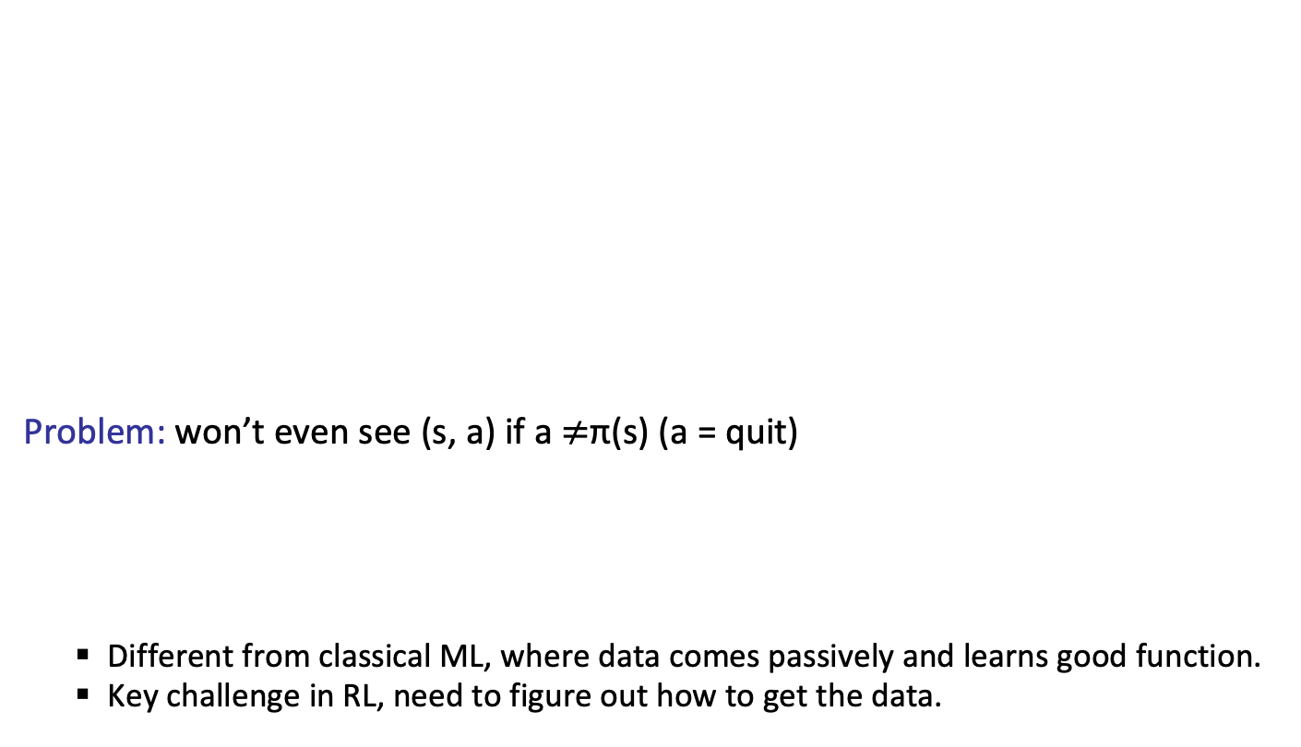
Model-Based Learning
Problem: won’t even see (s, a) if a $≠$π(s) (a = quit)
Different from classical ML, where data comes passively and learns good function.
Key challenge in RL, need to figure out how to get the data.
(4/7): $4
in stay
in,stay
quit
(3/7): $4
in,quit
?: $?
end
Key idea: exploration
To do reinforcement learning, need to explore the state space.

Slide 36
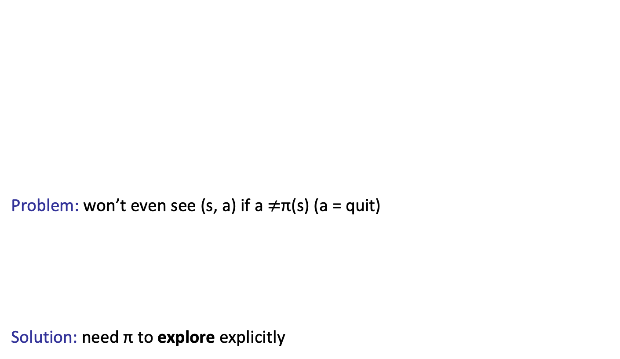
Model-Based Learning
Problem: won’t even see (s, a) if a $≠$π(s) (a = quit)
Solution: need π to explore explicitly
(4/7): $4
in stay
in,stay
quit
(3/7): $4
in,quit
?: $?
end
Key idea: exploration
To do reinforcement learning, need to explore the state space.

Slide 37
Model-Based Learning
Data (following policy π(s) = quit):
[in; quit, R, end]
Transitioning?
Reward?
(4/7): $4
in stay
in,stay
quit
(3/7): $4
in,quit
?: $?
end

Slide 38
Model-Based Learning
Notes:
Our policies have been deterministic. However, if we use such a policy to generate data, there are certain (s, a) pairs that we will never see and, therefore, never be able to estimate their Q-value and never know what the effect of those actions are.
This problem points at the most important characteristic of reinforcement learning, which is the need for exploration.
This distinguishes reinforcement learning from supervised learning, because now we actually have to act to get data, rather than just having data poured over us.
if π is a non-deterministic policy that allows us to explore each state and action infinitely often (possibly over multiple episodes), then the estimates of the transitions and rewards will converge.
Once we get an estimate for the T and R, we can simply plug them into our MDP and solve it using standard value or policy iteration to produce a policy.

Slide 39
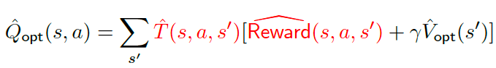
From model-based to model-free
All that matters for prediction is (estimate of) Q_{opt}(s, a).
Key idea: model-free learning
Try to estimate Q_{opt}(s, a) directly.

Slide 40
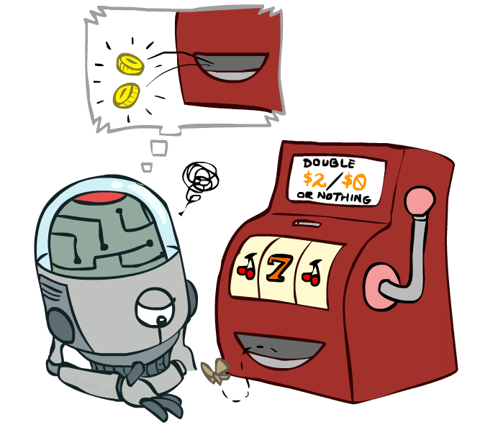
Model-Free Learning

Slide 41
Model-free Learning
Data (following policy π):
s₀; a₁, r₁, s₁; a₂, r₂, s₂; a₃, r₃, s₃; . . . ; a_{n}, r_{n}, s_{n}
Recall:
Q_{π} (s, a) is expected utility starting at s, first taking action a, and then following policy π
Utility:
u_{t} = r_{t} + γ · r_{t+1} + γ² · r_{t+2} + · · ·
Estimate:
Q^{ˆ} _{π} (s, a) = average of u_{t} where s_{t−1} = s, a_{t} = a
(and s, a doesn’t occur in s₀, · · · , s_{t−2})

Slide 42
Model-free Learning
Data (following policy π(s) = stay):
[in; stay, 4, end]
Utility?
(?): $?
?
in stay
in,stay
quit
(?): $?
?
in,quit
?: $?
end

Slide 43
Model-free Learning
Data (following policy π(s) = stay):
[in; stay, 4, end]
(?): $?
4
in stay
in,stay
quit
(?): $?
?
in,quit
?: $?
end

Slide 44
Model-free Learning
Data (following policy π(s) = stay):
[in; stay, 4, in; stay, 4, end]
Utility?
(?): $?
4
in stay
in,stay
quit
(?): $?
?
in,quit
?: $?
end

Slide 45
Model-free Learning
Data (following policy π(s) = stay):
[in; stay, 4, in; stay, 4, end]
(?): $?
(4+8)/2
in stay
in,stay
quit
(?): $?
?
in,quit
?: $?
end

Slide 46
Model-free Learning
Data (following policy π(s) = stay):
[in; stay, 4, in; stay, 4, in; stay, 4, in; stay, 4, end]
Utility?
(?): $?
(4+8)/2
in stay
in,stay
quit
(?): $?
?
in,quit
?: $?
end

Slide 47
Model-free Learning
Data (following policy π(s) = stay):
[in; stay, 4, in; stay, 4, in; stay, 4, in; stay, 4, end]
(?): $?
(4+8+16)/3
in stay
in,stay
quit
(?): $?
?
in,quit
?: $?
end

Slide 48
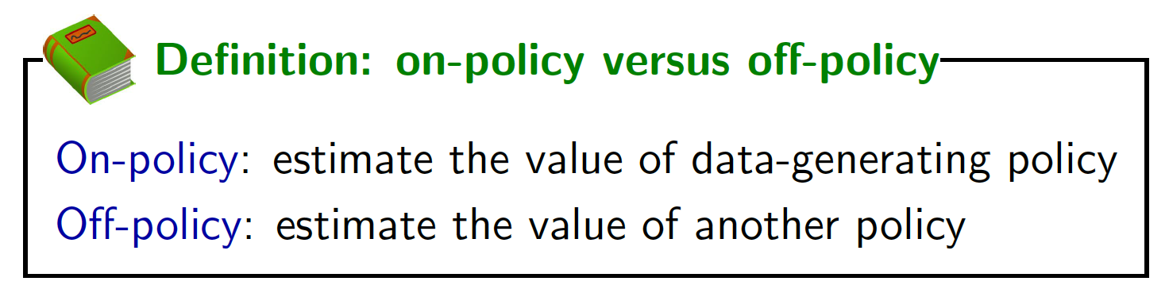
Model-free Learning
Data (following policy π(s) = stay):
[in; stay, 4, in; stay, 4, in; stay, 4, in; stay, 4, end]
Note: we are estimating Q_{π} now, not Q_{opt}
(?): $?
(4+8+16)/3
in stay
in,stay
quit
(?): $?
?
in,quit
?: $?
end

Slide 49
Model based vs model-free
?

Slide 50
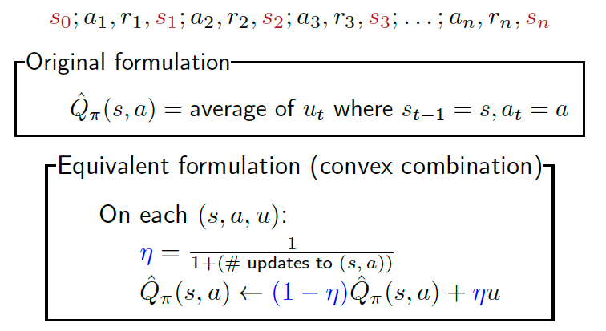
Model-free Learning (equivalences)
Data (following policy π):

Slide 51
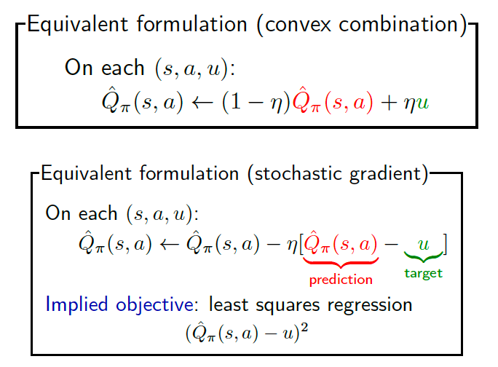
Model-free Learning (equivalences)

Slide 52
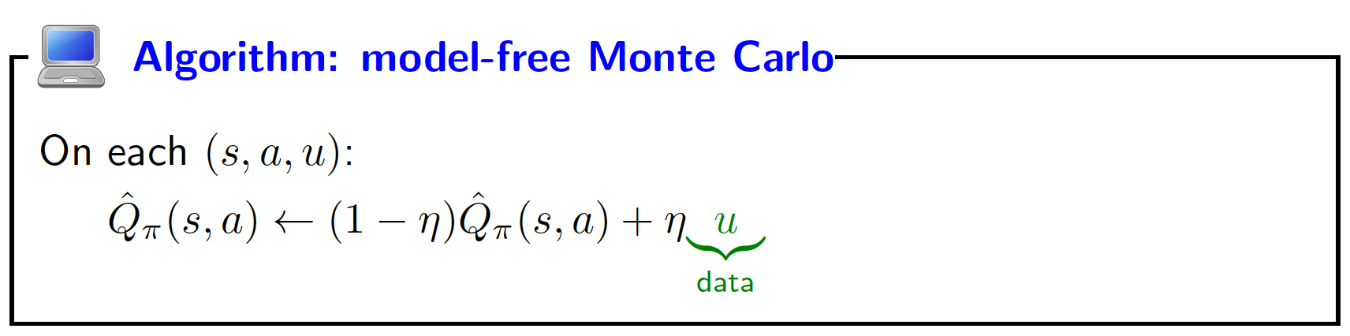
Model-free Learning (equivalences)
Data (following policy π(s) = stay):
[in; stay, 4, end] u = 4
[in; stay, 4, in; stay, 4, end] u = 8
[in; stay, 4, in; stay, 4, in; stay, 4, end] u= 12
[in; stay, 4, in; stay, 4, in; stay, 4, in; stay, 4, end] u= 16

Slide 53
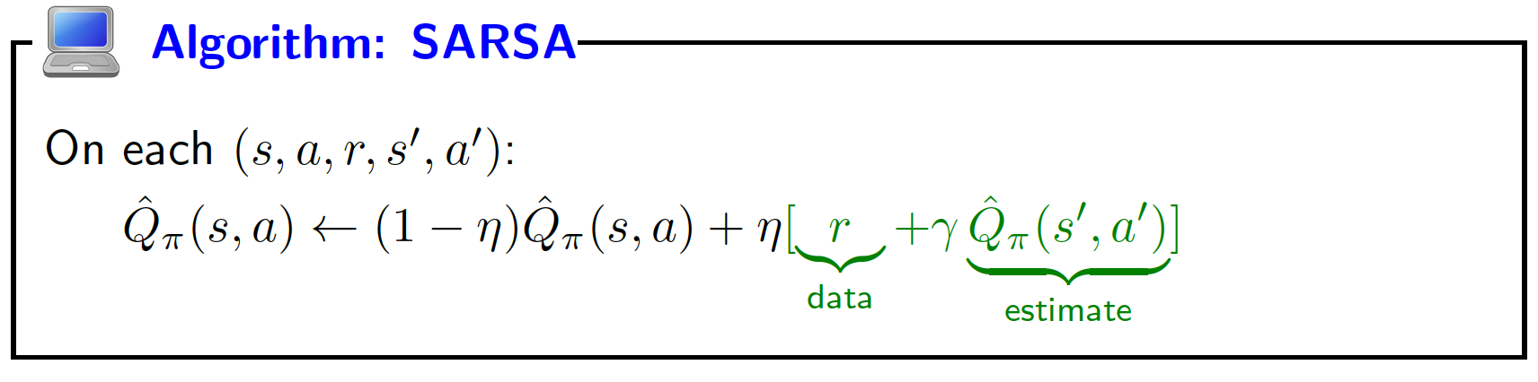
Using the reward + Q-value
Current estimate: Q^{ˆ}_{π} (s, stay) = 11
Data (following policy π(s) = stay):
[in; stay, 4, end] 4+0
[in; stay, 4, in; stay, 4, end] 4+11
[in; stay, 4, in; stay, 4, in; stay, 4, end] 4+11
[in; stay, 4, in; stay, 4, in; stay, 4, in; stay, 4, end] 4+11

Slide 54
Model-free versus SARSA
Key idea: bootstrapping
SARSA uses estimate Q^{ˆ}_{π} (s, a) instead of just raw data u.
u
based on one path
large variance
wait until end to update
r + Q^{ˆ}_{π} (s , a ) based on estimate
small variance
can update immediately

Slide 55
Question
Which of the following algorithms allows you to estimate Q_{opt}(s, a) (select all that apply)?
model-based learning
model-free learning
SARSA

Slide 56
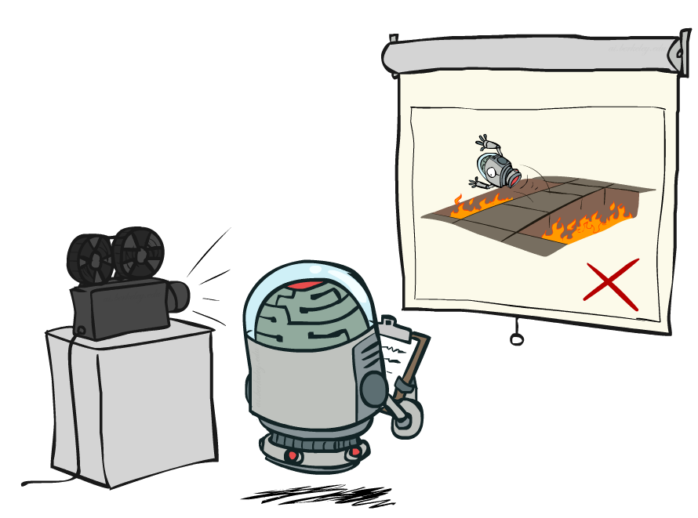
Passive Reinforcement Learning

Slide 57

Passive Reinforcement Learning
Simplified task: policy evaluation
Input: a fixed policy π(s)-- told what to do
You don’t know the transitions T(s,a,s’)
You don’t know the rewards R(s,a,s’)
Goal: evaluate how good an optimal policy is,
learn the expected utility U for each s
In this case:
Learner is “along for the ride”
No choice about what actions to take
Just execute the policy and learn from experience
This is NOT offline planning! You actually take actions in the world.

Slide 58
Direct Evaluation
Goal: Compute values for each state under π
Idea: Average together observed sample values
Act according to π
Every time you visit a state, write down what the sum of discounted rewards turned out to be
Average those samples
This is called direct evaluation

Slide 59
Problems with Direct Evaluation
What’s good about direct evaluation?
It’s easy to understand
It doesn’t require any knowledge of T, R
It eventually computes the correct average values, using just sample transitions
What bad about it?
It wastes information about state connections
Each state must be learned separately
So, it takes a long time to learn

Slide 60
Adaptive Dynamic Programming (ADP)
Smarter method than Direct Utility Estimation.
Estimating the utility of a state as a sum of reward for being in that state and the expected discounted reward of being in the next state.
Converges fast but can become quite costly to compute for large state spaces.
ADP is a model-based approach
ADP adjusts the utility of s with all its successor states

Slide 61
Temporal Difference Learning (TD)
model-free approach
not require to learn the transition model
update occurs between successive states and agent only updates states that are directly affected
TD learning adjusts the utility of s with that of a single successor state s’

Slide 62
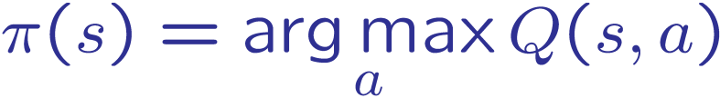
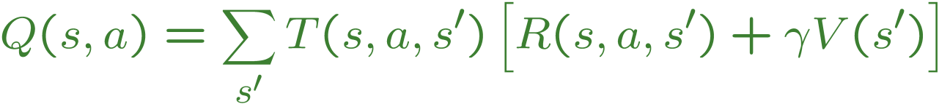
Problems with TD Value Learning
TD value leaning is a model-free way to do policy evaluation
However, if we want to turn values into a (new) policy, we’re sunk:
Idea: learn Q-values, not values
Makes action selection model-free too!
s
a
s, a
s,a,s’
s’

Slide 63
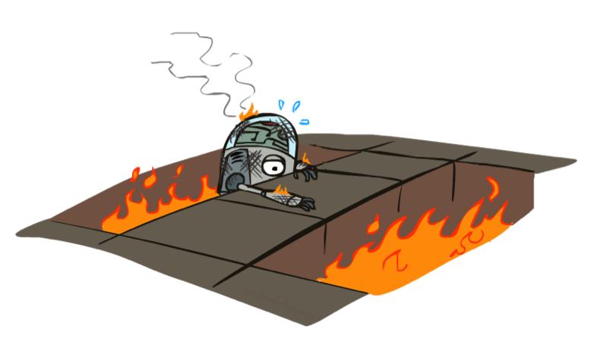
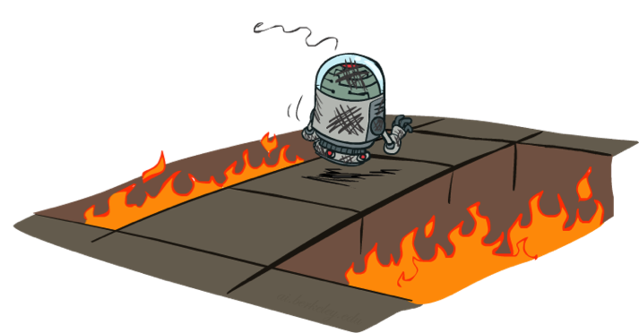
Active Reinforcement Learning

Slide 64
Active Reinforcement Learning
Problem: model-free and SARSA only estimate Q_{π} , but want Q_{opt} to act optimally
Output
Q_{π} Qopt
MDP
policy evaluation value iteration
reinforcement learning
model-free, SARSA
Q-learning

Slide 65
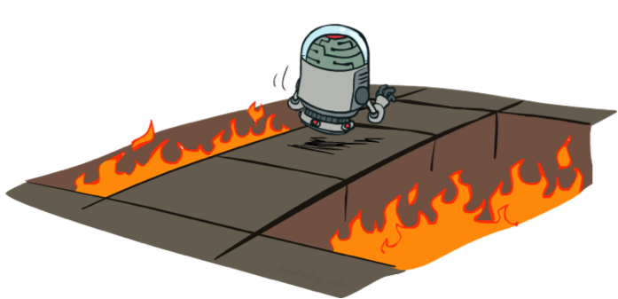
Active Reinforcement Learning
Full reinforcement learning: optimal policies (like value iteration)
You don’t know the transitions T(s,a,s’)
You don’t know the rewards R(s,a,s’)
You choose the actions now
Goal: learn the optimal policy / values
In this case:
Learner makes choices!
Fundamental tradeoff: exploration vs. exploitation
This is NOT offline planning! You actually take actions in the world and find out what happens…

Slide 66
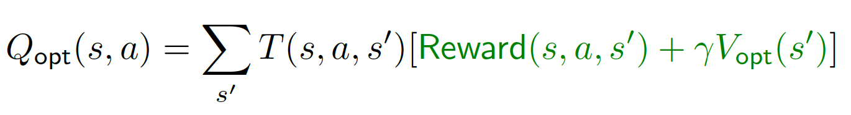
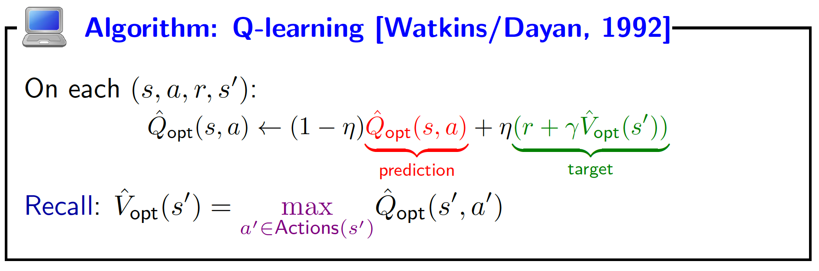
Q-Learning
MDP recurrence:

Slide 67
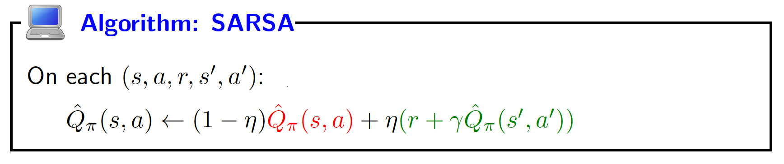
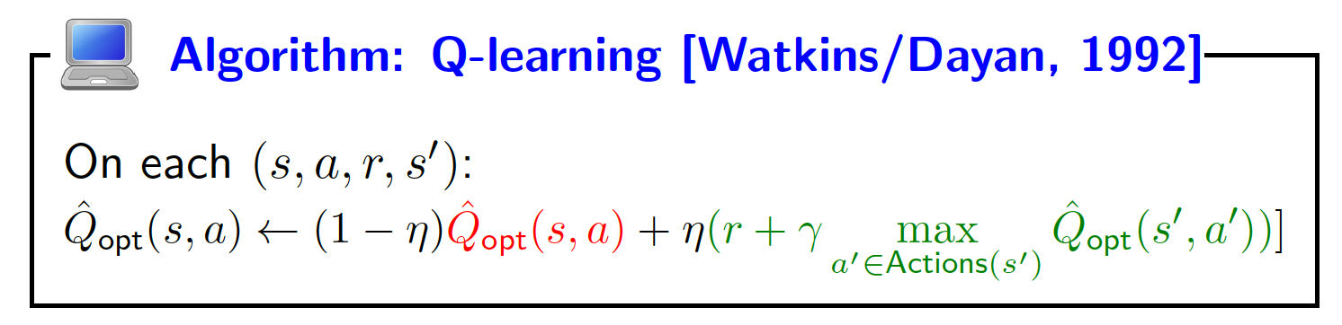
SARSA versus Q-learning

Slide 68

Q-Learning Properties
Amazing result: Q-learning converges to optimal policy -- even if you’re acting suboptimally!
This is called off-policy learning
Caveats:
You have to explore enough
You have to eventually make the learning rate
small enough
… but not decrease it too quickly
Basically, in the limit, it doesn’t matter how you select actions (!)

Slide 69
How to Explore?
Algorithm: reinforcement learning
For t = 1, 2, 3, . . .
Choose action a_{t} = π_{act}(s_{t−1}) (how?)
Receive reward r_{t} and observe new state s_{t}
Update parameters (how?)
s₀; a₁, r₁, s₁; a₂, r₂, s₂; a₃, r₃, s₃; . . . ; a_{n}, r_{n}, s_{n}
Which exploration policy π_{act} to use?
Notes:
Show robot-soccer learning to walk videos (UT Austin):
? Show snake robot:

Slide 70
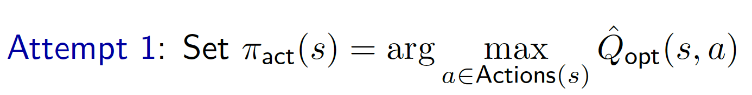
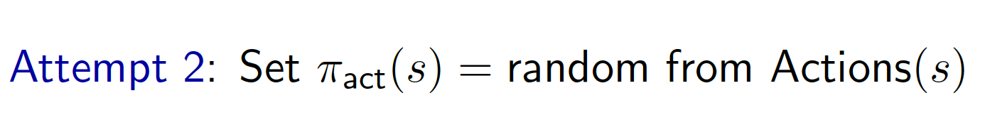
Exploration/exploitation tradeoff
No exploration, all exploitation
No exploitation, all exploration

Slide 71


Exploration/exploitation tradeoff
Key idea: balance
Need to balance exploration and exploitation.
Examples from life: restaurants, routes, research

Slide 72

How to Explore?
Several schemes for forcing exploration
Simplest: random actions (ε-greedy)
Every time step, flip a coin
With (small) probability ε, act randomly
With (large) probability 1-ε, act on current policy
Problems with random actions?
You do eventually explore the space, but keep thrashing around once learning is done
One solution: lower ε over time
Another solution: exploration functions for large state space

Slide 73
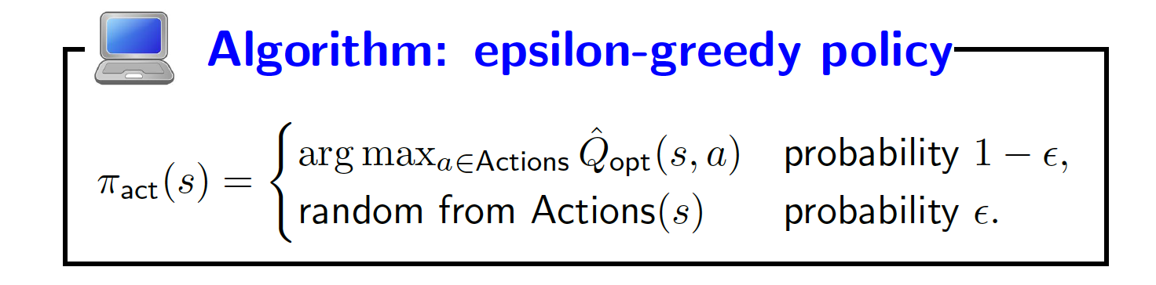
ε-greedy

Slide 74
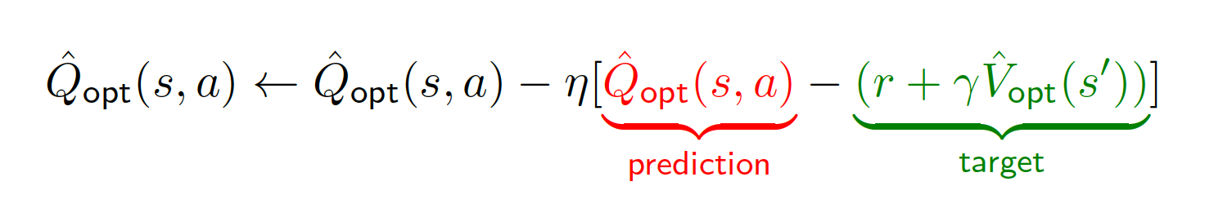
Q-Learning
Stochastic gradient update:
This is rote learning: every Q_{opt}(s, a) has a different value
Problem: doesn’t generalize to unseen states/actions

Slide 75
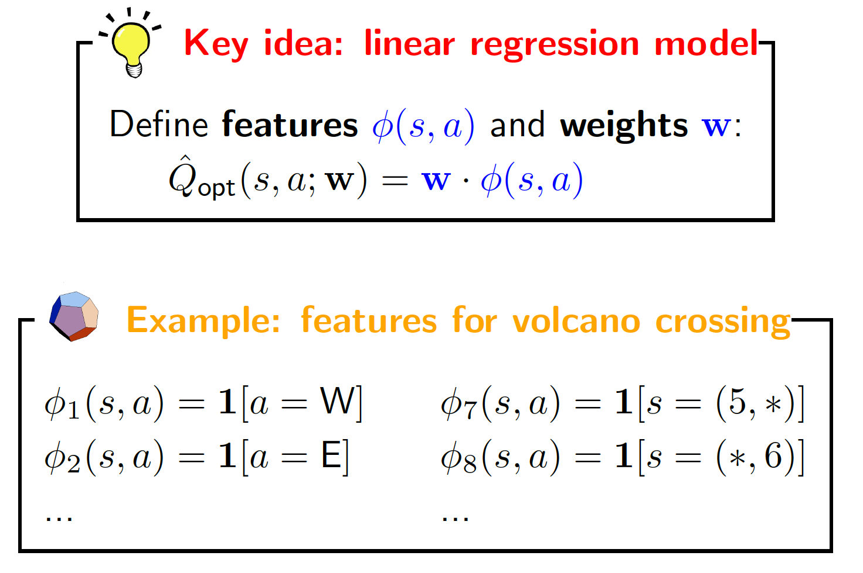
Function approximation

Slide 76
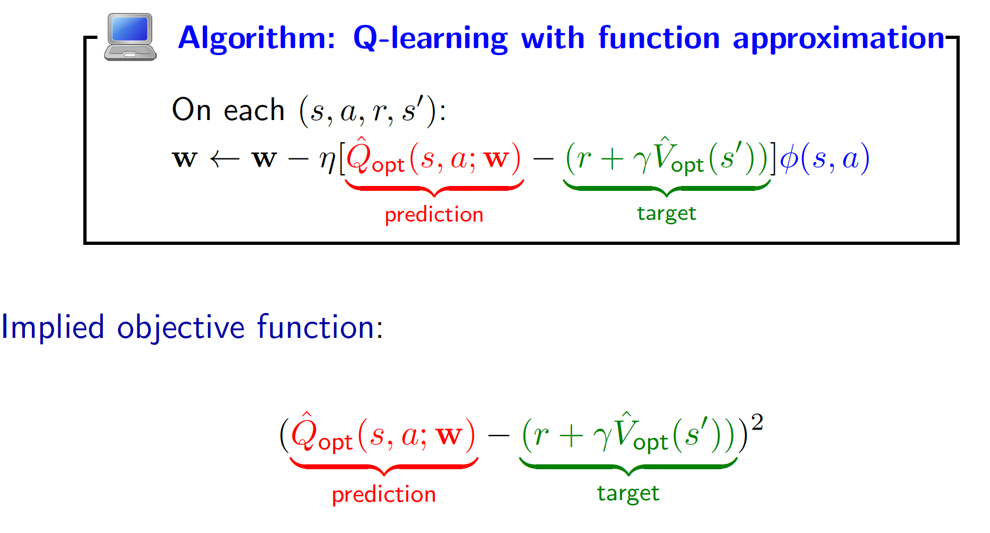
Function approximation

Slide 77
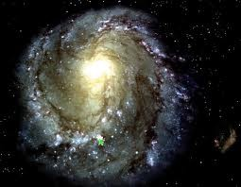
Covering the unknown
Epsilon-greedy: balance the exploration/exploitation tradeoff
Function approximation: can generalize to unseen states

Slide 78
Summary so far
Online setting: learn and take action in the real world!
Exploration/exploitation tradeoff
Monte Carlo: estimate transitions, rewards, Q-values from data
Bootstrapping: update towards target that depends on estimate rather than just raw data

Slide 79
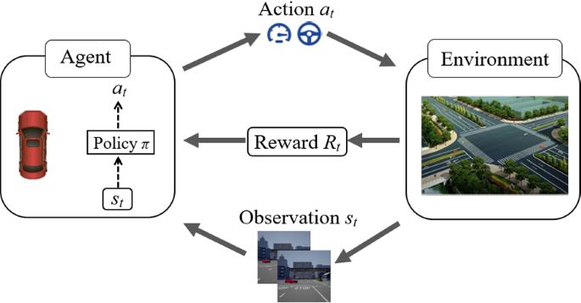
Applications- Autonomous cars
https://link.springer.com/article/10.1007/s42154-020-00113-1

Slide 80
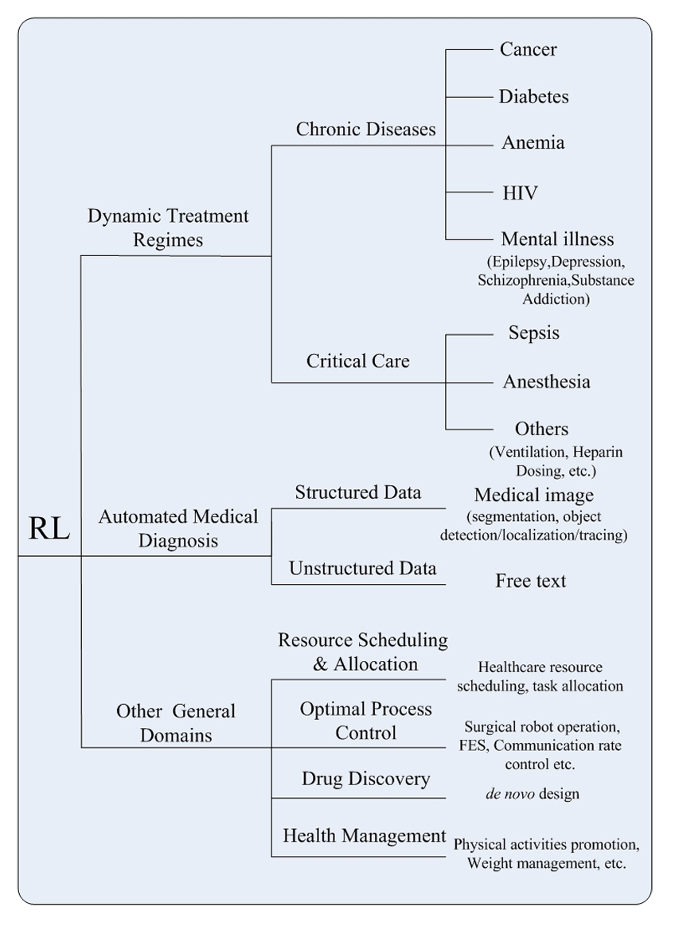
Applications- Healthcare
Reinforcement Learning in Healthcare: A Survey

Slide 81
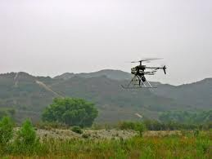
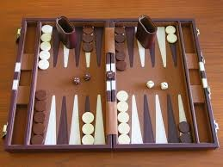


Applications
Autonomous helicopters: control helicopter to do maneu- vers in the air
Backgammon: TD-Gammon plays 1-2 against itself, human-level performance
million
games
Elevator scheduling; send which elevators to which floors to maximize throughput of building
Managing datacenters; actions: bring up and shut down machine to minimize time/cost

Slide 82
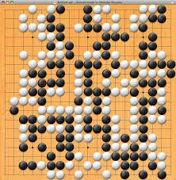
Deep reinforcement learning
Policy gradient: train a policy π(a | s) (say, a neural network) to directly maximize expected reward
Google DeepMind’s AlphaGo (2016), AlphaZero (2017)
Andrej Karpathy’s blog post
http://karpathy.github.io/2016/05/31/rl
https://www.youtube.com/watch?v=SUbqykXVx0A

